Slide 1
Fitbit to BellaBeat
Market Data Insight
Analyst : Adeboyeje Isaac

Slide 2
Executive Summary
FitBit users are engaged in sedentary activities for majority of the day.
FitBit app does not actively track data for 24hrs but for majority of the day.
There are inconsistencies between recorded data and calculated data.
A few key metrics for Fitbit app user data:
Data monitored showed that all users raked in a monthly percentage sedentary minutes per user between 47% and 91% in a month month.
The user with most sleep minutes per month had an average of 60.88%.
The average FitBit inactive minutes for all users per month was 3hrs 35 minutes.
BellaBeat needs to focus its growth on products that track sedentary activities and users who spend majority of their day sedentary as data showed that all users raked in a combined average of 69.39% sedentary minutes per month.
BellaBeat also needs to focus their market growth on wearable, longer lasting and active products as data shows an average 14% daily time of app inactivity.
BellaBeat needs to create products with more sensitive calibrations

Slide 3
Overall,
Users spend majority of their days engaged in sedentary activities
as their % sedentary minutes per month fell between 45.99% and 91.49%
with an average of 69.39% for all users.

Slide 4
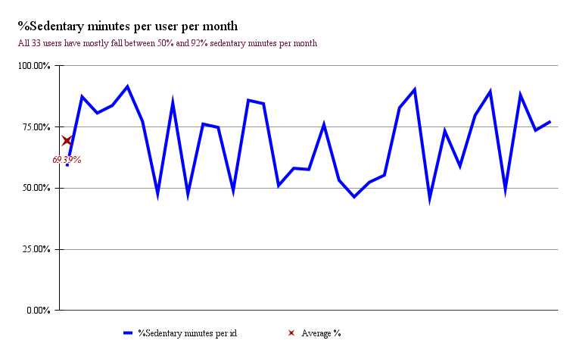

Slide 5
For the recorded sleep data,
The user with the most monthly sleep minutes had :
% sleep minutes per sedentary minutes that fell between 38.77% and 92.75%
and a combined average %sleep per sedentary minutes per day of 60.88%.

Slide 6
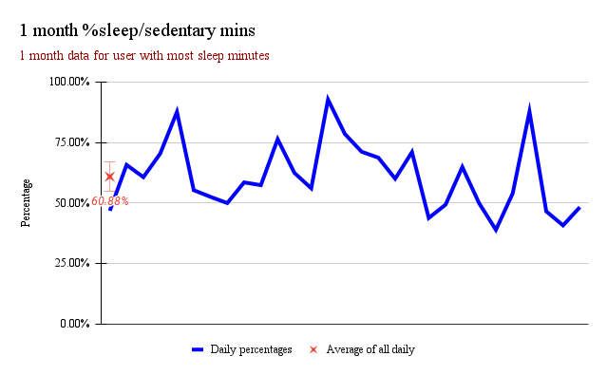

Slide 7
For the period of app inactivity,
Recorded data showed that the application had
monthly inactive times for all users that fell between 12 minutes and 8 hours : 49 minutes.
With an overall average of 3 hours and 35 minutes.

Slide 8
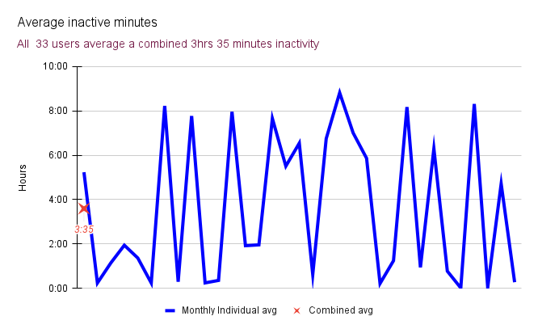

Slide 9
Because majority of the day is spent in sedentary activities,
the tracker distance and combined active, moderate and light sedentary activities i.e “CS” were compared for equality.
Of the 940 data observations, app tracker distance was found to be unequal to CS in 539 observations and only equal on 401 occasions.

Slide 10
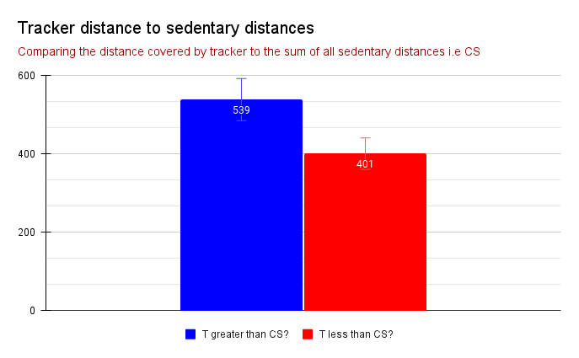

Slide 11
The daily and hourly calorie data for a user were compared for consistency and equality.
Of the 30 days observation, hourly burnt calories for 24 different days was found to be unequal to the recorded daily burnt calories.
Hourly burnt calories for 6 different days was however found to be consistent and equal to the pre-recorded daily burnt calories.

Slide 12
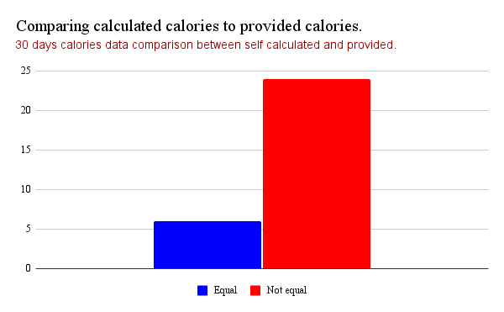

Slide 13
Potential causes of concern
Period of app inactivity and inconsistent data:
Usage mismatch
Hypotheses:
Users take device off during time of recess and other physiological needs.
Data required
Other physiological data (e.g when do you take the device off and for how long, how long do you spend in the bathroom, toilet, kitchen, do you take it off during copulation? )
Analysis next step
Is there a significant time difference between the time device is worn and taken off?
When is the device mostly taken off and for what?
Period of device inactivity and inconsistent data:
Device mismatch
Hypotheses:
Device’s battery isn't strong enough to last a whole day.
Device’s processor overclocks causing calibration issues.
Data required
Breakdown of device’s overall battery capacity and battery usage per process.
Does the device go to sleep and when? Does it automatically come awake?
Breakdown of device’s processing power and requirement per activity.
Analysis next steps
Is battery power more than sufficient to carry all activities for 24hrs without going to sleep?
Is the processor strong enough to run processes smoothly without overclocking and causing calibration issues?

Slide 14
App and Usage mismatch: What is our strategy?
Light weight and user friendly device : The product designers should come up with an easy to use and understand device that is also almost not felt when worn for its target market.
Fluid and fall proof device : A light weight, fluid and crack proof device for users would be the appropriate everyday companion for users.
Device processor and calibration sysetem : Processor that never feels warm or run hot and an always online and sensitive calibartion system would track and collate data appropriately.
Battery, sleep and hibernation : Battery with enough juice to last more than a day for all activities and processes with no need to go to sleep or hibernate is good for the target market.
Define the main advantages of this new device over previous devices : Test this device in a controlled population and get both quantitative and qualitative data from the population to highlight the main advantages of this new device.
Create a targeted marketing and go-to market plan for the target audience : Identify the target market where the ROI is greates and begin from there.

